Slide 1
Anti-Money Laundering Directive (6AMLD)

Slide 2
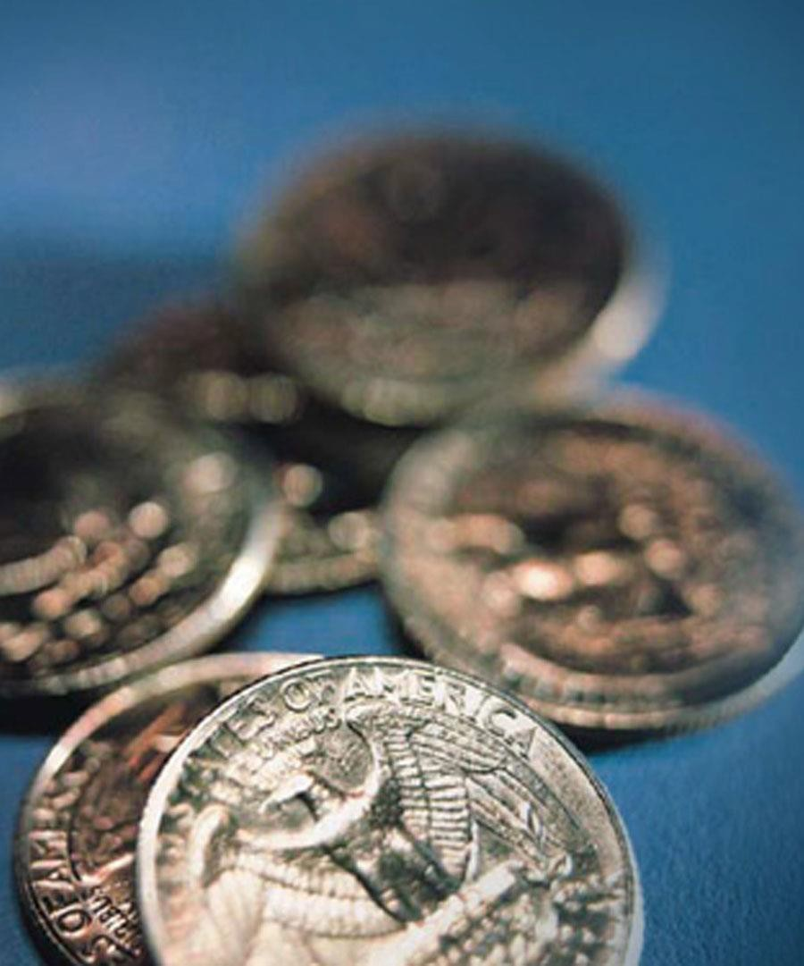
Learning Objectives
What is 6MLD?
What’s new and what’s changed under 6MLD?
Your responsibilities
What we should do to get ready
Our company’s AML/CTF policy

Slide 3
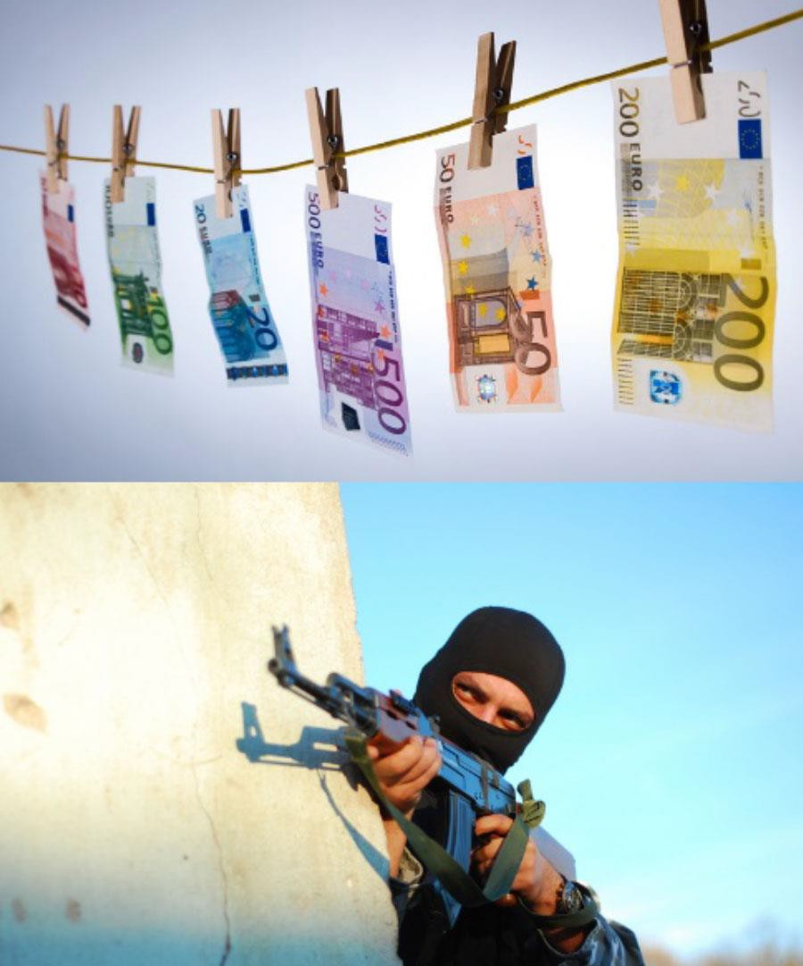
What is 6MLD?
The Sixth Anti-Money Laundering Directive:
Dual criminality for specified offences and greater co-operation
Harmonisation and clarification of predicate offences
Extension of criminality to legal persons
A tougher punishment regime overall
Additional offences, such as aiding and abetting

Slide 4
What is money laundering?
…the process by which criminals attempt to conceal the
identity, source or destination of illicit funds
Dirty Money Clean Money
1.
Placement
2.
Layering
3.
Integration

Slide 5
Four categories of money laundering
Converting or transferring property, knowing it’s derived from criminal activity, to conceal the illicit origin or assist those involved in criminal activity to evade the law
Acquiring, possessing or using property, knowing at the time of receipt that it was derived from criminal activity or from participating in criminal activity
Concealing or disguising the true nature, source, location, disposition, movement, rights, with respect to, or ownership, of property knowing it’s derived from criminal activity
Participating in, association to commit, attempting to commit and aiding, abetting, facilitating and counselling the commission of any of the above

Slide 6
What is terrorist financing?
Where money is raised for an offence that has yet to be committed
Difficult to identify
Funded from legitimate or apparently legitimate sources
Wealthy individuals
Commercial enterprises
Charities and religious organisations
State sponsors

Slide 7
Think about it: Is it money laundering?
“I only deal with other financial institutions so there’s no risk of money laundering"
Correct Incorrect
✓

Slide 8
You make the call: Is it money laundering?
“I deal mainly with business accounts so I’m unlikely to encounter money launderers there"
Correct Incorrect
✓

Slide 9
When it goes wrong
Danske Bank faces $2bn fine for money laundering in Estonia
Deutsche Bank fined $150m for dealings with Epstein and AML failings
Westpac pays
$1.3bn in money laundering case
Standard Chartered fined £842m by US and UK regulators for AML and sanctions violations
Betway pays record
£11.6m for money laundering failures

Slide 10
What’s new?
Greater co-operation between member states to prosecute offences
Harmonisation and clarification of predicate offences
Dual criminality for specified offences
Extension of criminal liability to legal persons and key business leaders
Additional offences, such as aiding and abetting
A tougher punishment
regime overall

Slide 11
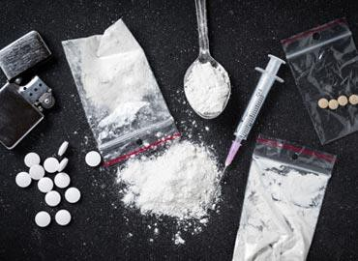
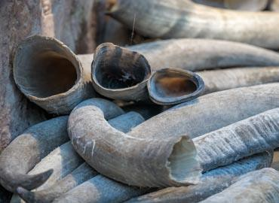
What’s changed?
Dual criminality for specified offences
Greater co-operation between member states – enabling prosecutions in a single member state
Harmonisation and clarification of predicate offences

Slide 12
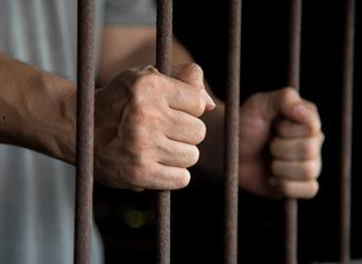
What’s changed? (Cont’d)
Extension of criminal liability to firms and those in authority – holding those in authority to account for AML failings
A tougher punishment regime – increasing minimum prison terms for money laundering from one to at least four years
Additional offences to pursue enablers or facilitators of money laundering

Slide 13
Think about it: Is it True or False?
“Honestly, I don’t see what environmental
crime has to do with money laundering.
It’s not really relevant."
True False ✓

Slide 14
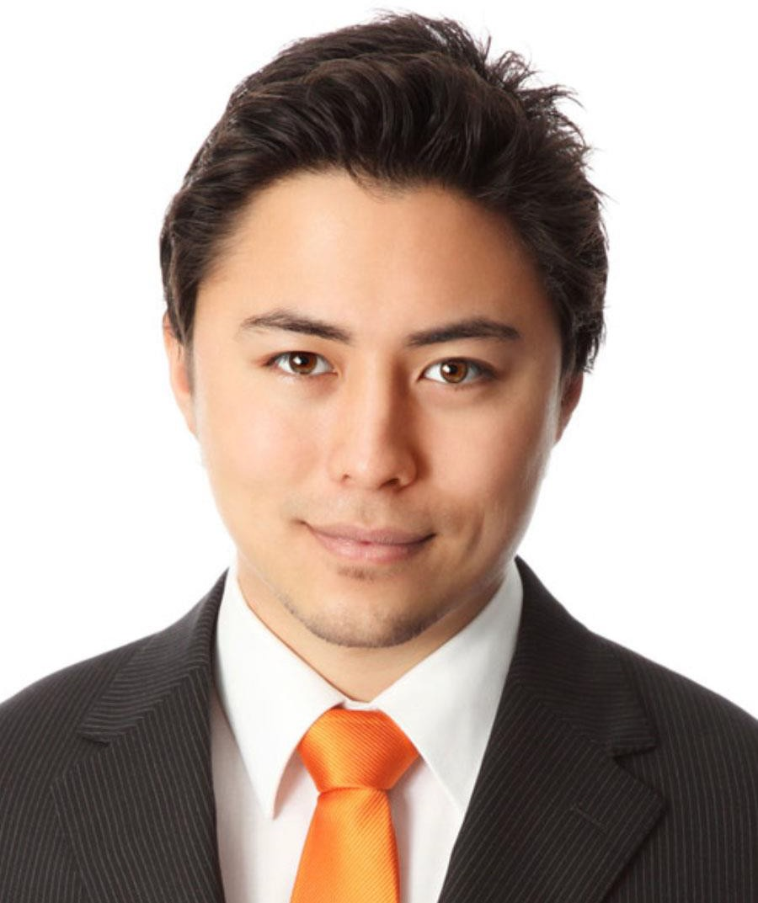
Think about it: Is it True or False?
“In future, firms can expect to be held much more accountable for AML compliance failings. Those in authority may face prosecution for poor supervision.”
True False
✓

Slide 15
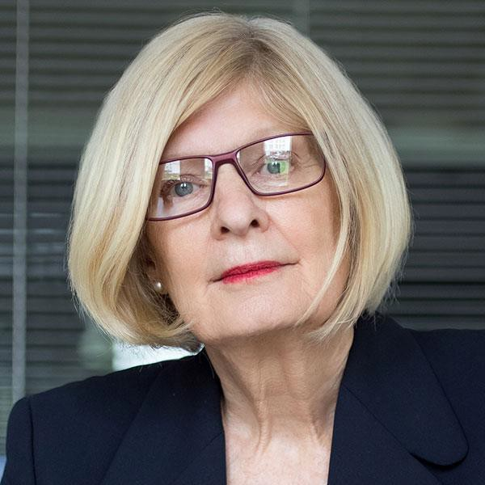
Think about it: Is it True or False?
“As a legal advisor, it is not my job to prevent money laundering. I can’t be expected to scrutinise every client. I don't see what I can do anyway.”
True ✓
False

Slide 16
10%
Penalties
€5
million
Cease and desist orders
of total annual
turnover
Publicly issued reprimands
Financial and reputational damage

Slide 17
Sanctions for legal persons
Exclusion from public funding, aid or tenders
Temporary or permanent ban from the sector
Judicial supervision
Enforced closure and winding-up

Slide 18
Our AML/CTF Policy
Encouraging everyone to get involved
Appointing people with a specific responsibility for handling suspicious activity or transactions (MLRO)
Co-operating fully with regulators and law enforcement to tackle money laundering and terrorist financing
Requiring everyone to read and implement our Cyber Security Policy

Slide 19
Do
Read our Company's AML/CTF Policy – make sure you understand the rules
and why they're important
Conduct appropriate risk-based due diligence
Know how to spot 'red flags' - ie unusual or suspicious activity
Make sure you know the name of your MLRO and how to contact them
Be aware of high-risk non-EU countries with deficient AML/CTF regimes (those on the 'blacklist') – take extra care with transactions involving people or entities based there
Report any knowledge or suspicion of money laundering or terrorist financing immediately

Slide 20
Don’t
x Assume that another colleague, department or company has made the necessary due diligence checks
x Make payment transfers to people or entities in high-risk non-EU countries without conducting enhanced due diligence
x Leave it for someone else to report concerns about suspicious customers or transactions
x Delay making reports or wait until you have gathered more evidence - the faster you make your report, the better
x Never bypass any of our controls to circumvent AML/CTF regulations or
assist clients with this – you will be caught!

Slide 21
What we should do to get ready
Awareness, training and information – is everyone aware of the pending
changes with 6AMLD and its impact on them? (including senior management)
Review our current AML/CTF regime and framework – especially awareness of the predicate offences, the risks and typologies, dual criminality for specified offences, and the detection of potential enablers
Explore Regulatory Technology (RegTech) solutions to deliver more sophisticated monitoring and ease the regulatory burden
Put mechanisms in place to improve co-operation with competent authorities
in other member states where offences span different jurisdictions
Monitor and review - benchmarking

Slide 22
6AMLD & you
Discuss:
How will 6MLD impact on our business unit, department, function and/or firm?
Key priorities
[Allow 15mins]

Slide 23
Next steps
Check ouT the Company Manual and Policy documentation
Access self-study courses on our e-learning portal for further training
Take the Assessment and earn a Certificate

Slide 24
About GRC Gulf
GRC Gulf provides digital learning content, technology and services to help you train your staff, automate your compliance processes and generate management reports to help you keep track of it all.
Our comprehensive Compliance Course library contains many modules from high-level standards, industry conduct and thematic topics to AML/CTF, Anti-Bribery and Risk Management
Learn more at: https://grcgulf.com
Copyright © 2024 GRC Gulf. All Rights Reserved.

